Slide 1
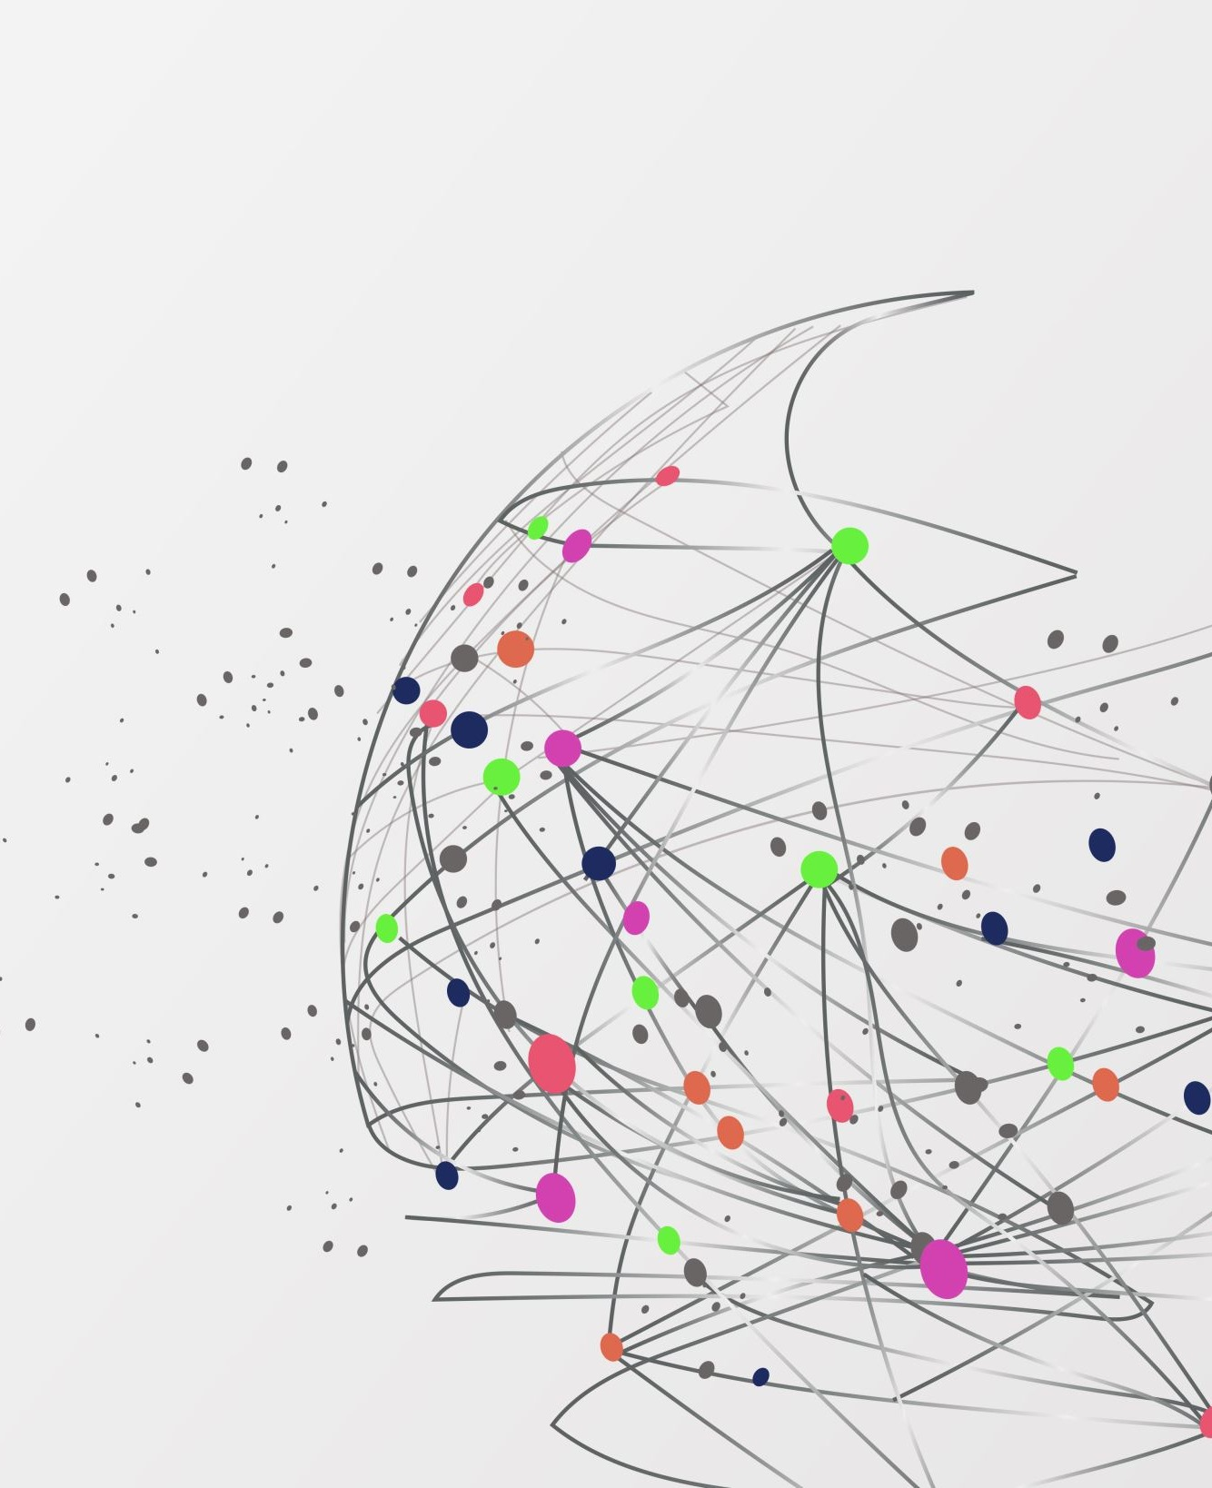
Data Science for Everyone
What is data, and what can we do with it?

Slide 2
By the end of this course you will
1
Know the basics of data science
The 7 steps, types of data, simple statistics and how models predict.
2
Manipulate data yourself
Clean, explore, build features and model data in Orange, with no coding.
3
Use Gen AI ethically
Know its limits, check its answers and protect people’s privacy.

Slide 3
How you will be graded
10%
10 quizzes
Short quizzes
25%
Assignment 1
Given Week 3, due Week 6
30%
Assignment 2
Given Week 7, due Week 11
35%
Final project
Weeks 12 to 15
Total: 100%

Slide 4
What is data?
Data is recorded information about the world.
Facts we can store, count and compare.
A number
A word
A picture
A sound
A place
A click
If it can be recorded, it can be data.

Slide 5
Data comes in many types
Numbers
Today’s temperature, your height, a test score
Text
A tweet, a text message, a novel
Images
A selfie, an X-ray, a microscope photo of metal
Audio and video
A voice memo, a song, a security camera clip
Location
Your phone’s GPS trail, a delivery route
Behavior
Clicks, likes, steps walked, items bought

Slide 6
Example of data
A table row
Muffin · $2.50 · 9:15 AM · Cash
A text
“The line was long, but the coffee was great!”
A sensor reading
Room temperature: 21.5 °C at 3:00 PM

Slide 7
What is a dataset?
A dataset is data organized as a table.
Row = observation
One student, one sale, one printed part.
Student | Major | Hours studied | Coffee cups
Student 1 | CS | 4 | 1
Student 2 | MechE | 2 | 0
Student 3 | Philosophy | 5 | 2
Student 4 | Finance | 2 | 3
Column = variable
One thing we measured about each row.

Slide 8
What is data science?
Using data to answer questions and make better decisions.
Understand the problem
Find patterns
Get results
Tools and software
Orange | Python | MATLAB

Slide 9
Data science in many domains
Domain | What data science can do
Manufacturing | Predict defects in 3D printed parts, quality control
Healthcare | Flag patients at higher risk using their record
Digital humanities | Find themes across thousands of books and letters
Sports | Pick lineups and strategy from player statistics
Business | Forecast demand for a product, profit, loss
Environment | Predict floods, heat waves and air quality

Slide 10
You already use data science every day
Where you meet it | What it predicts | Data it learns from
Music and video apps | What you will want next | What you played, skipped and liked
Maps and traffic | How long the trip will take | Speeds and locations from many phones
Email spam filter | Spam or not spam | Words, senders, what people reported
Bank fraud alert | Is this purchase yours? | Your past purchases and locations
Online games | A fair opponent for you | Win rates and skill ratings
A model learns a pattern from past data, then predicts something new.
Notes:
Start with their phones. Each of these is a data science result: a model learned a pattern from past data and predicts something about you. Ask students which of these they used today. Point out the third column: every one of these runs on data about people, which is why we spend a week on ethics later in the course. Keep this short, about three minutes, and move on to the cycle.

Slide 11
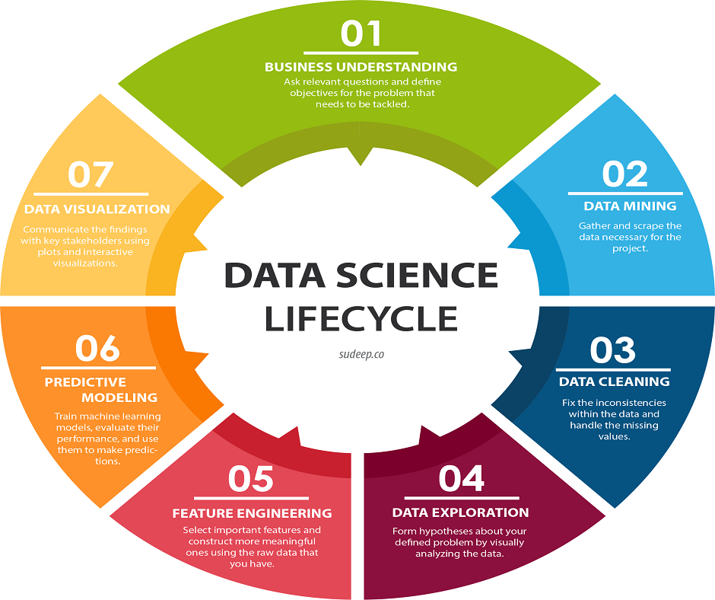
The data science cycle
1 Business understanding
2 Data mining and extraction
3 Data cleaning
4 Data exploration
5 Feature engineering
6 Predictive modelling
7 Data visualization

Slide 12
One example through the whole cycle
Step | Example: which players will quit a game?
1 Business understanding | Question: find players likely to leave, so we can offer help
2 Data mining and extraction | Get the account table and the play logs
3 Data cleaning | Fix typos, remove duplicate and impossible rows
4 Data exploration | Plot hours played and look for outliers
5 Feature engineering | Build Days Since Last Login, encode Platform
6 Predictive modelling | Predict Yes or No: will this player quit?
7 Data visualization | Chart the quit rate by platform for the manager
Notes:
Walk the seven steps with one question students will meet again: which game players are likely to quit? This is the Player Churn lab dataset used later in Assignment 1 practice. Each row of the table is a week of the course: step 1 and 2 are Week 2, cleaning is Week 3, exploration is Week 4, features are Weeks 5 and 6, and so on. The point is that the steps come in order and each one depends on the one before: a model trained on dirty data gives wrong answers.

Slide 13
Business understanding
Step 1 of 7
What it means
Understand the problem, who it matters to, and what a good answer looks like.
Campus café example
The café throws away muffins every day. Question: how many should we bake each morning? Success: less waste and no sold-out shelves.
We practice this in Weeks 1 and 2 · Made-up example

Slide 14
Data mining and extraction
Step 2 of 7
What it means
Find where the data lives and collect it: public datasets, files, databases, websites, surveys.
Campus café example
Export three months of sales from the cash register. Add the daily weather and the class schedule from public sources.
We practice this in Week 2 · Made-up example

Slide 15
Data cleaning
Step 3 of 7
What it means
Fix wrong, missing and repeated data so we can trust it. Dirty data gives wrong answers.
Campus café example
A register glitch logged −5 muffins sold. One sale appears twice. “Blueberry”, “blueberry ” and “Bluebery” are the same flavor.
We practice this in Week 3 · Made-up example

Slide 16
Data exploration
Step 4 of 7
What it means
Summarize and plot the data to see patterns and surprises before building any model.
Campus café example
Find the average muffins sold per day. A chart shows Fridays are low and rainy days are high.
We practice this in Week 4 · Made-up example

Slide 17
Feature engineering
Step 5 of 7
What it means
A feature is a column a model learns from. Create useful new columns and drop the ones that do not help.
Campus café example
Turn the date into “day of week”. Add “is it raining?”. Drop the receipt number, which tells the model nothing.
We practice this in Weeks 5 and 6 · Made-up example

Slide 18
Predictive modelling
Step 6 of 7
What it means
A model learns patterns from past data and uses them to predict new cases. We always test it on data it has not seen.
Campus café example
Train on two months of sales. Test on the last month. Then predict tomorrow’s muffin sales.
We practice this in Weeks 7 and 9 · Made-up example

Slide 19
Data visualization
Step 7 of 7
What it means
Show the results clearly and honestly so other people can act on them.
Campus café example
One chart of predicted and actual sales by weekday, with a plain recommendation the manager can follow.
We practice this in Week 10 and the final project · Made-up example

